Slide 1
In the name of Allah All About CSDI
Central Securities Depository of Iran
8th – 10th Sep 2016 - Athens

Slide 2
Central Securities Depository of Iran
Agenda
1- Iran Capital Market
2- CSDI Profile
3- CSDI IT Solutions

Slide 3
Market Structure
Securities and Exchange High Council
Policy Maker
Securities and Exchange Organization of Iran
Supervisory Body
Tehran Stock Exchange
Iran Fara Bourse
Iran Energy Exchange
Iran Mercantile Exchange
Exchanges
Central Securities Depository of Iran
Tehran Securities Exchange Technology Management
Information Dissemination and Services
Associations
Corroborative Bodies

Slide 4
Iran Capital Market Milestones
1967-TSE Officially Launched
1989-Privatization of Corporations
2005-New Regulatory Structure
Demutualization
2009-New Instruments and Institutions
2015- SEO Admitted as a Member of IOSCO

Slide 5
CSDI Foundation
2005
Securities Market ACT of IRI (Based on Demutualization(
2005
CSDI became functional on December 26, 2005
2006
Establishment of Securities & Exchange Organization (SEO) and (TSE) in November 2006
2005
Establishment of CSDI under paragraph 7, article 1 of the law

Slide 6




Exchanges
Tehran Stock Exchange
Iran Fara Bourse
Iran Mercantile Exchange
Iran Energy Exchange
Equity Shares
Rights Offerings
Sukuk
Derivatives
ETFs
Equity Shares
Rights Offerings
Sukuk
Derivatives
Housing Mortgage Rights
ETFs
Intellectual Property
Industrial Goods
Oil & Petrochemicals
Agricultural Goods
Futures on Commodities
Mercantile CDs
Electricity
Oil & Gas
Other Energy Carriers

Slide 7
Market Participants
Companies & Financial Institutions | 2014 | 2015
Brokerage Houses | 107 | 107
Investment Banks | 8 | 9
Financial Advisory | 20 | 24
Portfolio Management | 79 | 87
Data Processing Companies | 5 | 5
Investment Funds and Holding Companies | 121 | 131
Listed Companies | 374 | 384

Slide 8

CSDI Main Roles
Pre-Trade
Trade
Post Trade
Registry & Depository
Risk Management
Clearing & Settlement

Slide 9
CSDI Subsidiaries and Relationships
SEO
Issuers
Exchanges
Investors
Brokers
Central Asset Management co.
Samat Samaneh

Slide 10
Central Asset Management Co.
Established in August 2010
For management and establishment of SPVs
Handling all logistical services for SPVs
As an investors’ trustee
Preserving the shareholders’ interests
Making them sure of issuer’s accurate performance
Monitoring and controlling the securities issuance operation processes
CSDI holds about 49% of CAM`s shares

Slide 11
CAMC in Regulations
SPV is a financial entity established to finance large projects through Islamic contracts which aims to reduce the risk and increase the clarity
Article 12:
Tax exemption on proceeds from selling the asset to the SPV
Article 11:
SPV tax exemption on financing proceeds
Article 1:
Possibility of using Islamic contracts in securities issuances
Legislation of “Development of new financial instruments & institutions " law in August 2010

Slide 12
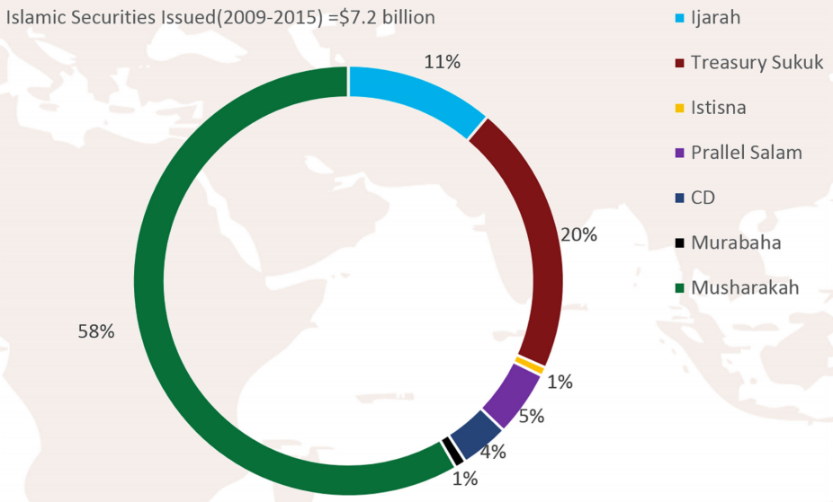
Some Facts and Figures

Slide 13

Samat Samaneh Co.
Established in 2012
For designing, implementing and supporting IT systems and network
CSDI holds 99.98% of Samat Samaneh`s shares

Slide 14
Main Functions of CSDI
Registration & Depository for different kinds of securities and contracts
Clearing and Settlement for TSE, IFB, IEE & IME (in near future)
Corporate Actions
Risk Management

Slide 15
Depository & Registration
Depositing process starts with registering the securities issued by listed companies in central registry system
Registration of securities are done electronically in a book-entry form
Listed companies` shares are capable of trading at the exchanges a day after the depositing
A complete and unified database including all data of registered securities is utilized

Slide 16
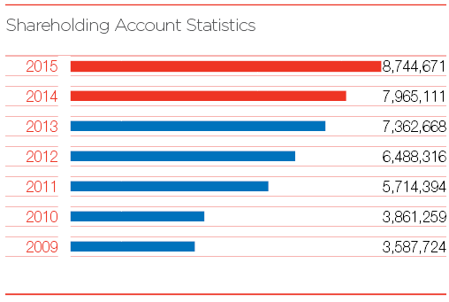
The number of shareholder accounts

Slide 17
Clearing & Settlement
All the securities Clearance
At T+0
Settlement of securities takes place at T+0
(Gross)
Money settlement takes place at T+3 for stock
(Net)
Money settlement take place at T+1 for fixed-income securities and at T+2 for ETFs

Slide 18
Corporate Actions
Process of
Corporate events
mandatory or voluntary
Issuing rights (capital increase) or dividend & interest distribution
Pledging
and legal transfer
E-voting
(in near future)

Slide 19
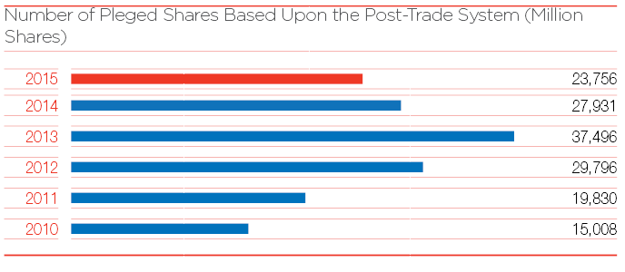
The number of pledged shares

Slide 20
Main CSDI Risks
Credit Risk (settlement)
Indirect Risks
Operational Risk
Legal Risk

Slide 21
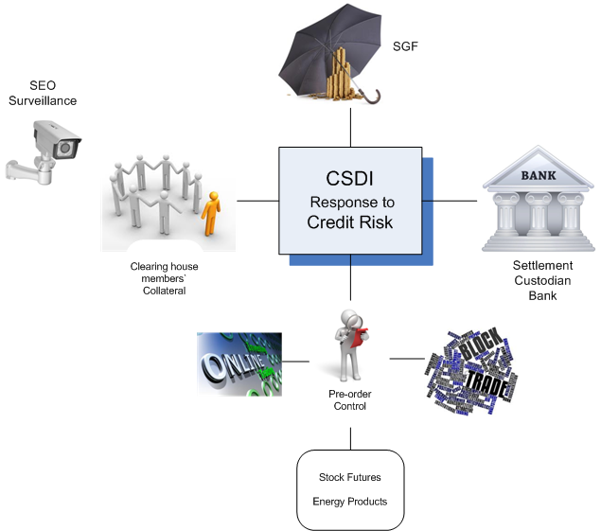

Slide 22
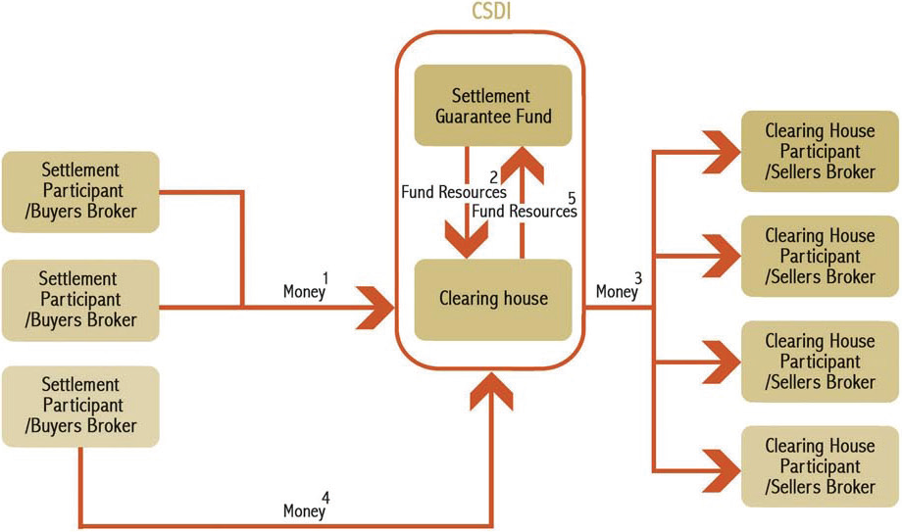
Settlement Guarantee Fund Model

Slide 23
Operational Risk Main Aspects
System & Technology
Process & Procedure
People & Counterparts

Slide 24
Response to Operational Risk System & Technology
Infrastructure
Solution
Business

Slide 25
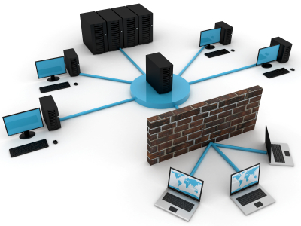
Response to Operational Risk - System & Technology
Infrastructure
IDS (Intrusion detection system)
Monitoring network or system activities for malicious activities or policy violations and producing reports to a management station
Air Gap (Air Wall)
Ensuring that a secure computer network is physically isolated from unsecured networks
Applying for registry system
Firewall

Slide 26

Response to Operational Risk - System & Technology
Solutions
Security in design
Backup
Hot
Cold
Replication
Redundancy mechanism & automatic results
control
Soft state (System disaster recovery plan)
Rule based system

Slide 27

Response to Operational Risk - System & Technology
Business
NetClear Dashboard
CertDistro
Smart algorithm for checking registered requests and generated certificates
Control on pledge
System Alarms
Data inconsistency
Test environment
Registry & clearing systems

Slide 28

Response to Operational Risk
People & Counterparts
Monitoring & Supervision
Training & Knowledge Enhancement
Technical Investigation of Offences
in Capital Market
Arbitration Commission
For cheat, theft, fraud, manipulation, etc

Slide 29
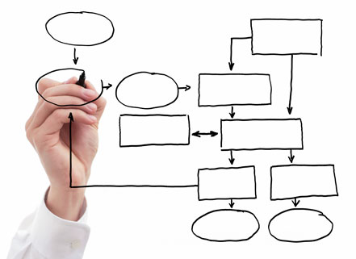
Response to Operational Risk
Process & Procedure
Cross-checking & 4-eye checking
Process reengineering
Problem solving task force

Slide 30
Response to Operational Risk
Legal Risk
National organization of civil registration
Data confirmation for account creation
IDMS (Intelligent Data Management System)
Legal & official certificates control
Image processing algorithm
Risk Transfer
Insurance cover (Near future)

Slide 31
Tax Services
Tax withholding for the investors
Tax reporting to authorized entities
Provide information in support of tax reclaims

Slide 32
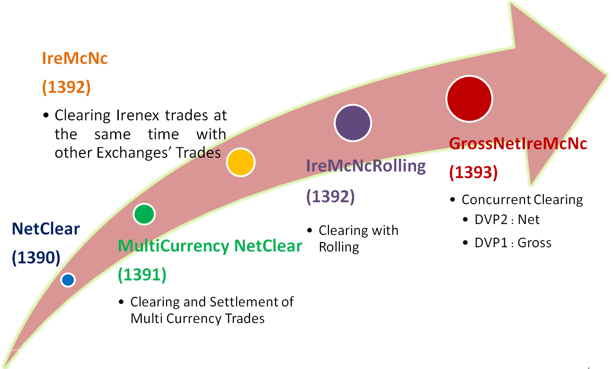
CSDI Services Division
Registry Systems
Clearing and Settlement Systems
Value Added Services

Slide 33


















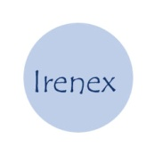











Other Systems

Slide 34

Thank you …
S.Siahkarzadeh@CSDIran.com

